Slide 1
Loan Performance Analysis
Presenter Name : VANI BHATT
Date : 26 - 12 - 2024
Power BI Dashboard Overview

Slide 2
Project Objectives & Dataset Overview
GOALS
Understand loan distribution across products and regions.
Identify default patterns and repayment trends.
Highlight operational inefficiencies for process improvements.
DATA CLEANING
No null values found
Age column had outliers replaced values with mode
Created new columns using formula for columns like “Loan Tenure(Months), EMI
DATASET OVERVIEW
Source: Synthetic dataset representing 10,000+ loan records.
Key Attributes:
Loan Details: Loan ID, Product Type, Amount, Start and End Dates.
Customer Details: Location, Age, Credit Score.
Loan Metrics: Loan Status, Interest Rate, Tenure, Late Payments.

Slide 3
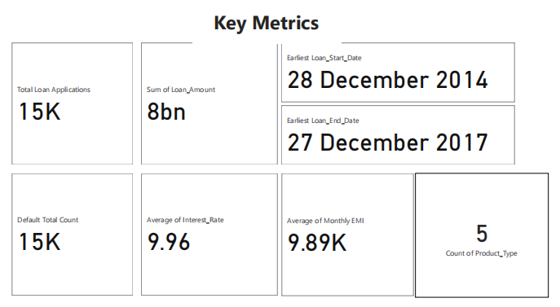
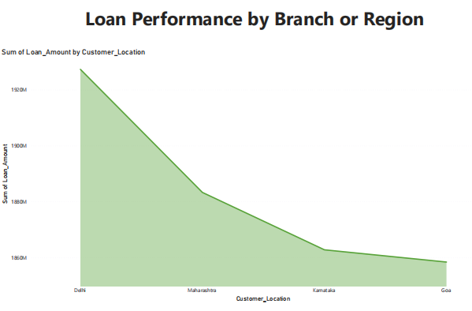
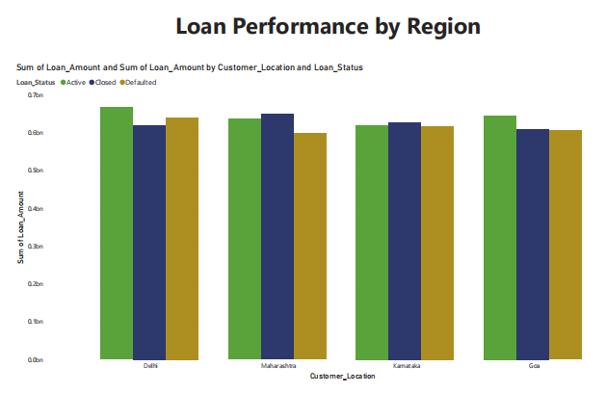
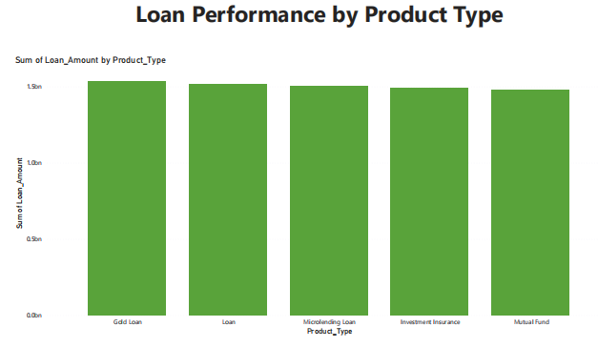
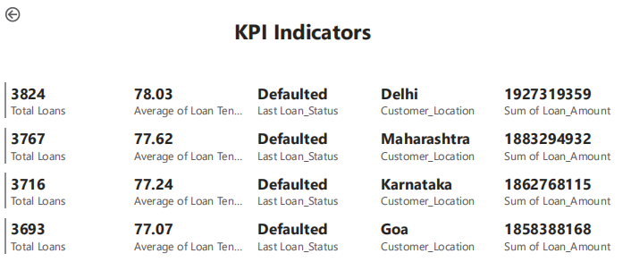
Key Metrics & KPIs
Total Loan Amount: 8bn
Total Number of Loans: 15k
Average Loan Tenure: 77 months
Default Rate: On avg 3k applicants in every region
As we can see that Loan amount distribution is almost same across all product types, regions.
Aslo there are equal number loan status of defaultes in every regions whcih is uncommon

Slide 4
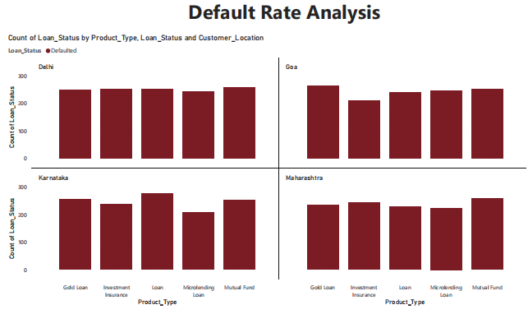
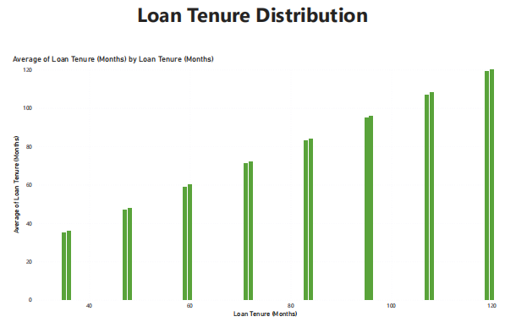
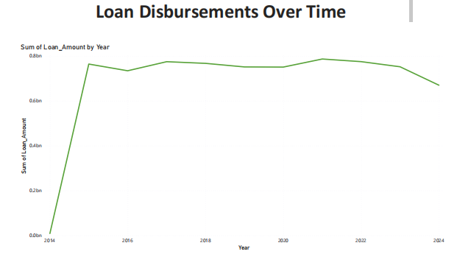
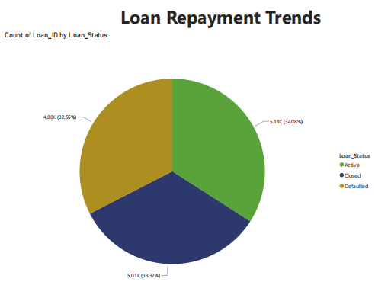
Default Rate by Region Visualization shows that goa has less number of defaulters as other regions by product type
Loan Tenure distribution chart shows that there loan tenure range is between 40 months to 120 months
Repayment Trends shows that there equal number of active,closed, defaul loan appliacants
Line chart shows that there is suddent hike in loan releases in the year 2014 and loan amoount has constant rate till 2024

Slide 5
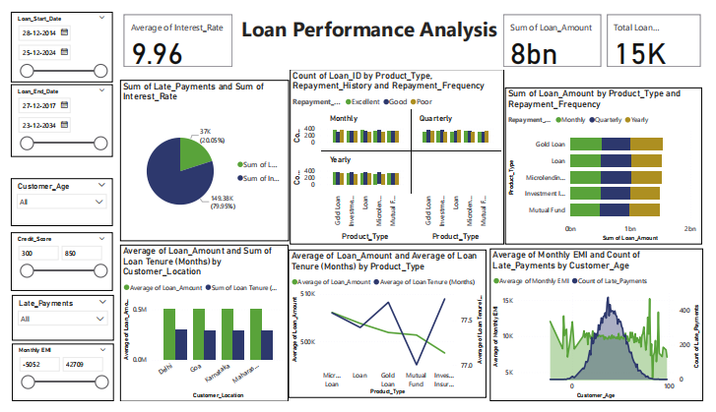
Insights
Highest defaults observed in Delhi region
Strong correlation between low credit scores and defaults.
Loan Distribution:
Majority of loans concentrated in Maharastra
Repayment Trends:
Significant proportion of loans are not actively repaid

Slide 6
Actionable insights for Stakeholders
Used the interactive dashboard to:
Analyzed loan performance across branches.
Identified actionable insights for risk mitigation.
Monitored key KPIs dynamically using slicers and filters.

Slide 7
Thank You!
Email: bhattvani91@gmail.com
Phone: 7977704007
LinkedIn: https://www.linkedin.com/in/vani-bhatt-b8a69a79/
Q&A: Open for any questions!

